Slide 1

Take The Cue
Guy Meyer meyerg
Eric Le Fort leforte
Andrew Danha danhaas
Ernest Selman selmae
Derek Savery saverydj
Max Moore moorem8

Slide 2
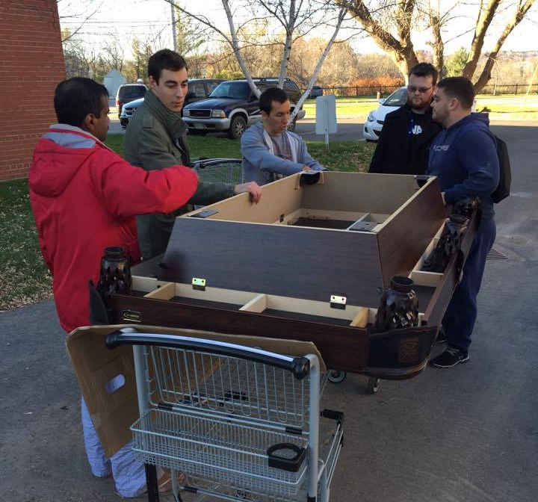
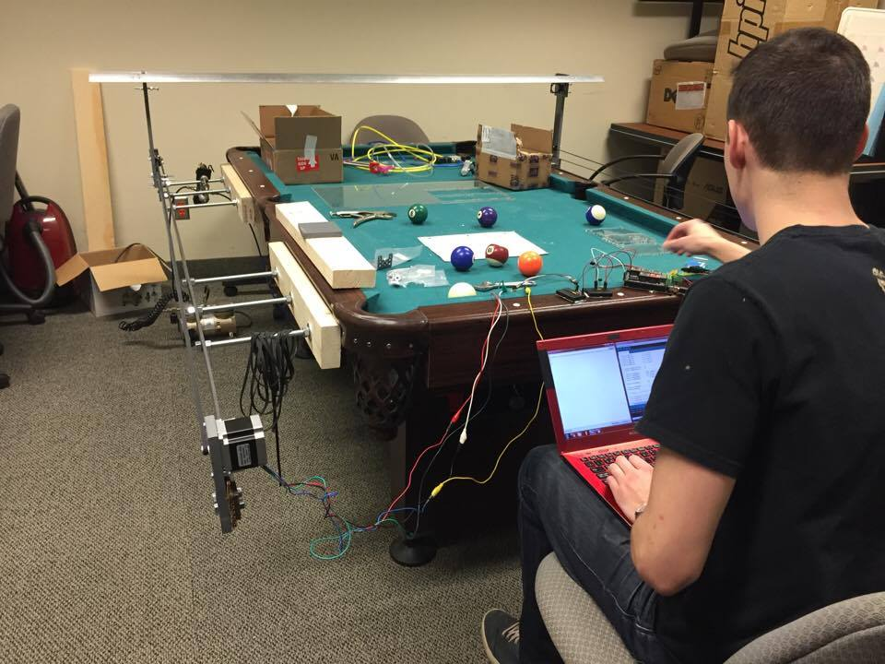
Our Team
Hardware Team
Guy and Ernest
Electrical and Controls Team
Andrew and Derek
Software Team
Eric and Max
Derek ‘working’

Slide 3
Everyone needs a pool partner!
Most existing solutions are prototypes
Too expensive
Too complex to operate
Our solution allows pool players to enjoy their table at all times
Customizable to many table sizes
Easy-To-Use Android module for Visual Recognition
Cost effective ( < $750 )

Slide 4

Project Summary
Autonomous solution for a pool playing partner
Visual Recognition to make its own decisions
Renders image and detects location of balls
Runs simulation to find best shot
Moves actuator to strike the white ball

Slide 5
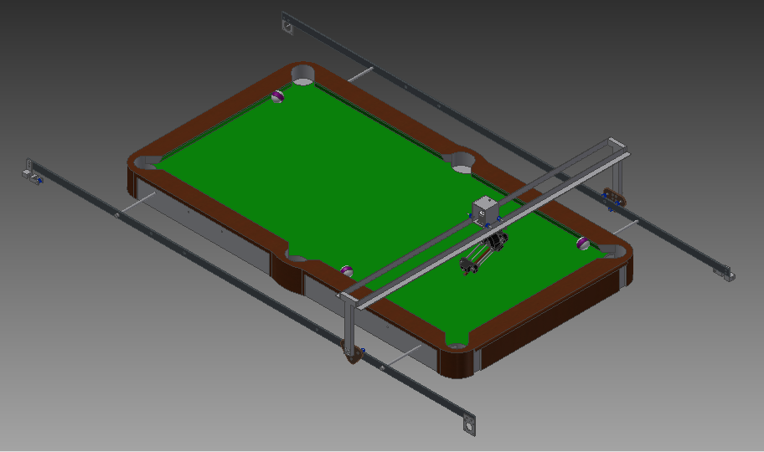
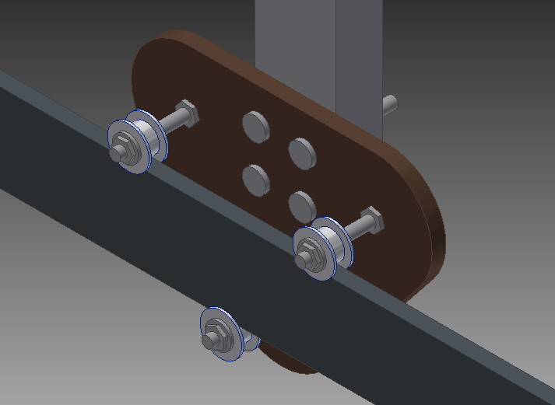
Hardware Advancements
X Rails work synchronously
Y Rail is as low as possible
Actuator Strikes ball with varying force
3 motions combine to align Actuator
X, Y and θ
X Rail
Y Rail
Arm Base
End Effector/Actuator

Slide 6
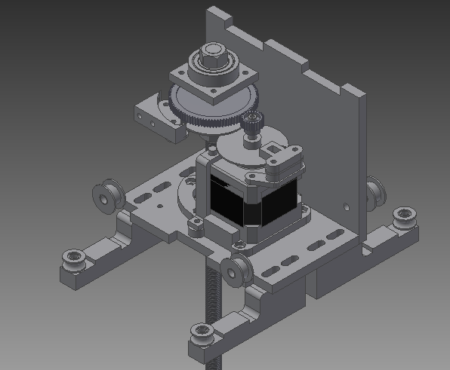
Rotating Mechanism
Uses NEMA 17 to preform motion
Gear Ratio => 4:1
Uses encoder to detect orientation
Rides two rails for stability
EE Base & Rotating Mechanism

Slide 7
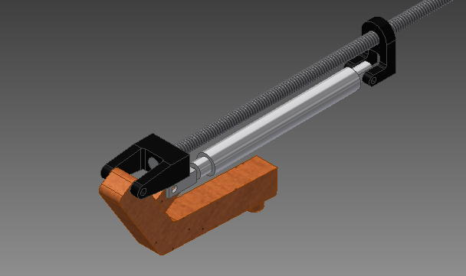
Hardware Hurdles
Hit balls while still moving around easily
Actuator tilted 20 degrees
Reaching the whole table
Move rails further out
Strike a ball with sufficient force
Electrical Motor or Pneumatics
Actuator

Slide 8
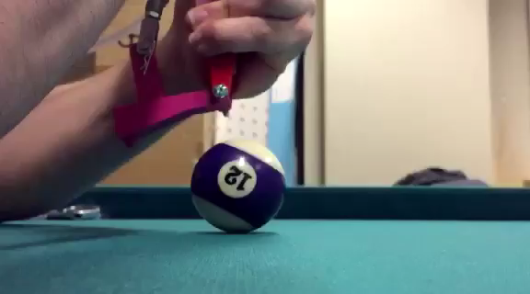
Hardware Demo – Shooting Mechanism

Slide 9
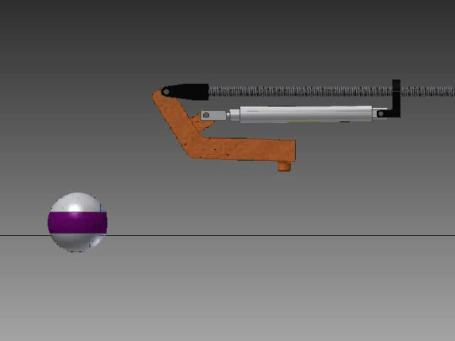
Remastered!

Slide 10
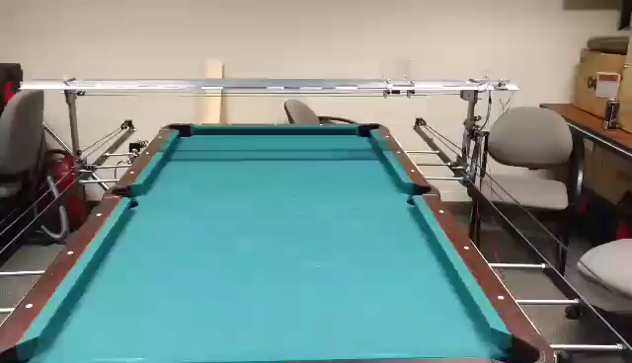
Hardware Demo – X & Y Rails

Slide 11
Electrical and Controls Summary
Arduino Mega 2560 interfaced with RAMPS 1.4
Design is simplified with modular motor drives
Endstops for controlling motors within bounds
Simple UI
2 buttons: user control button and move button
Colour changing LED to indicate system’s current mode

Slide 12
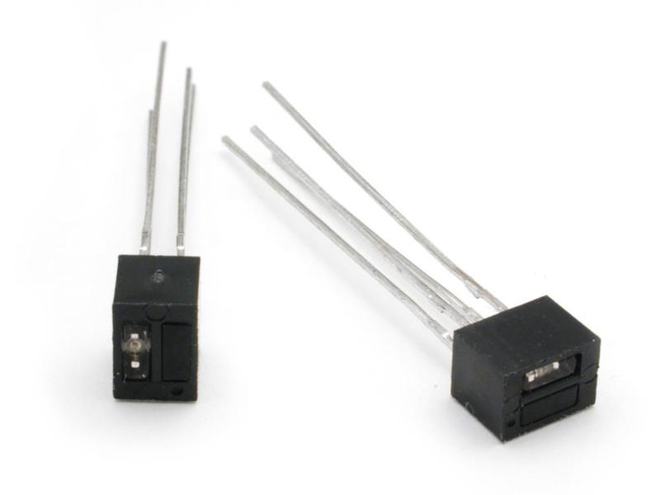
White Line Sensors
2 used in the rotational system
1 for each gear
When both sensors read low rotational system is at origin

Slide 13
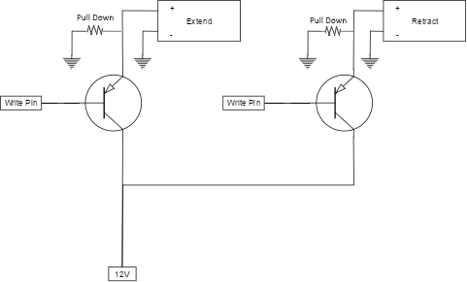
Pneumatic End-effector
BJTs used to control extension and retraction motion of piston

Slide 14
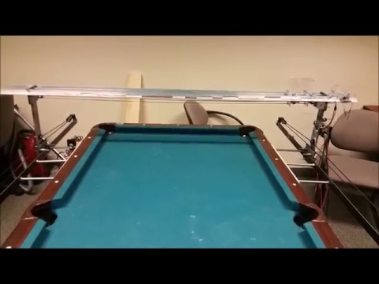
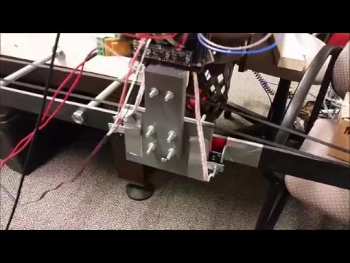
Electrical and Controls Improvements
Speed Up, Slow Down
End Stop Anticipation

Slide 15
Electrical and Controls Improvements #2
Simultaneous Motion

Slide 16
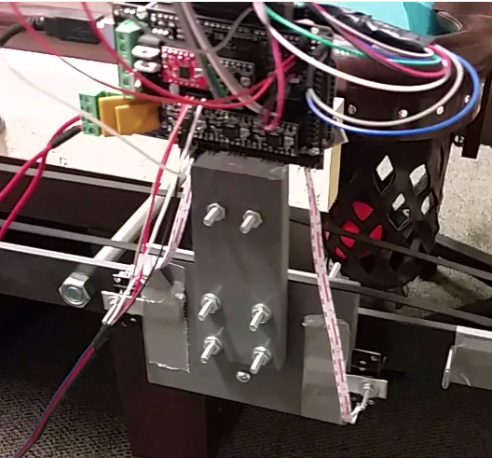
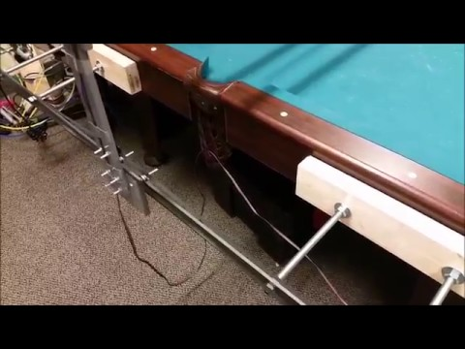
Electrical and Controls Hurdles
Wire management → MCU
Wire management → X Rails

Slide 17




Software Summary
Arduino program:
Receives user commands
Monitors sensor signals
Controls motors
Serial communication with PC
Android program:
Automated image capture
Socket communication with PC

Slide 18
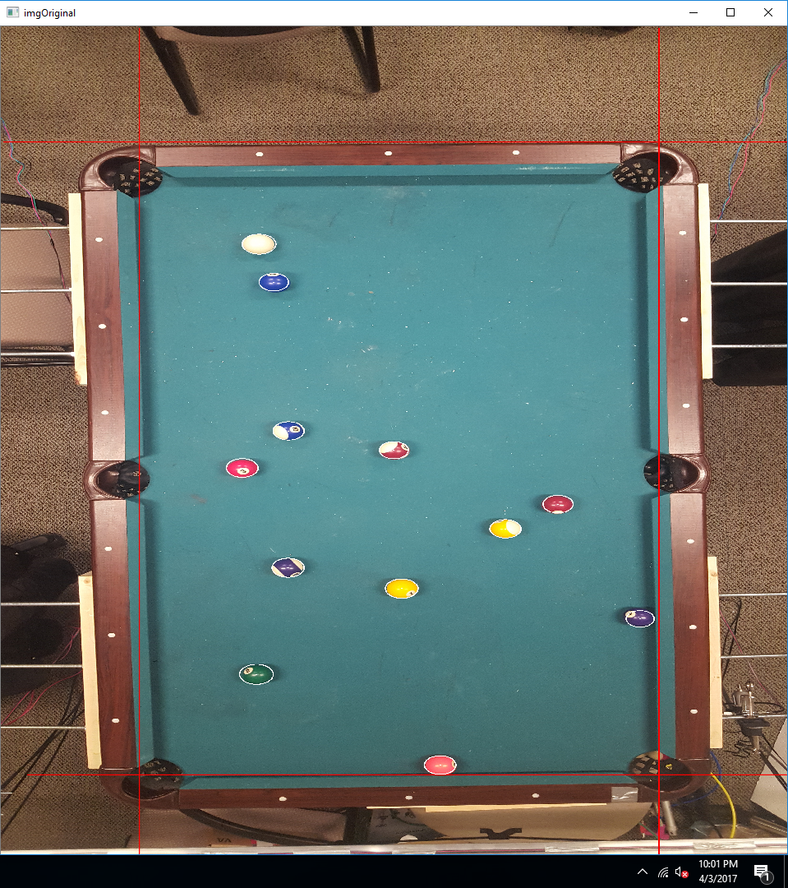
Software Summary (cont.)
Java program:
Various communication
protocols with other programs
Simulates shots to find the
optimal one
OpenCV program:
Object detection
Ball identification

Slide 19
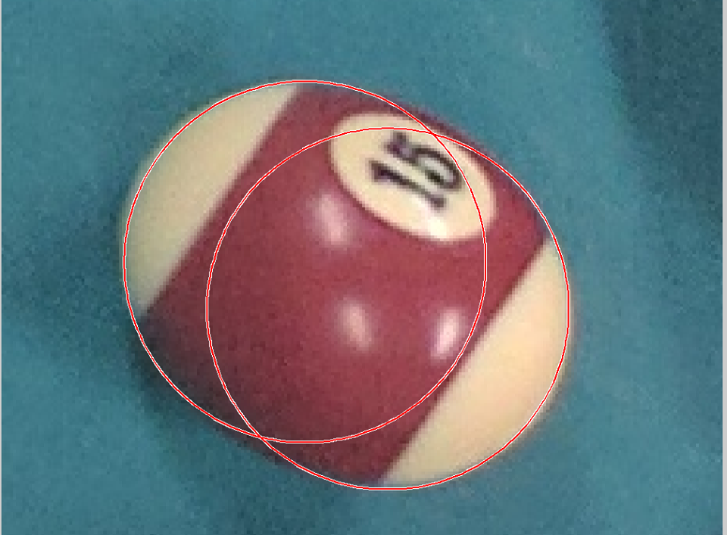

Software Hurdles
Object detection and identification
Relation of simulation to real worlds
Android emulator crashing often
Android uncooperative with
automated image capture

Slide 20
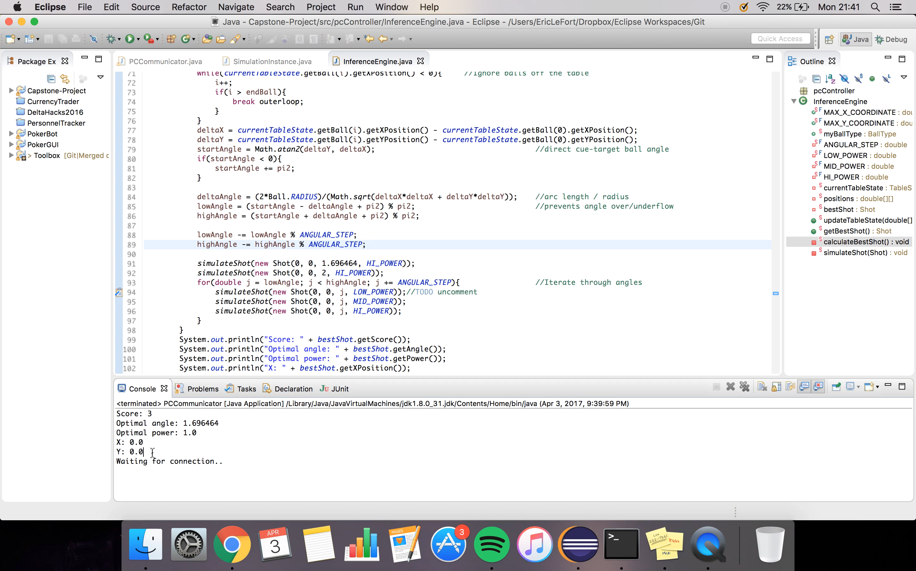
Software Demo

Slide 21
Thank You
For Listening
Questions?

